Slide 1
Introductory General Chemistry
Chemistry 3A
Experiment 5a
Empirical Formula
Mitch Halloran

Slide 2
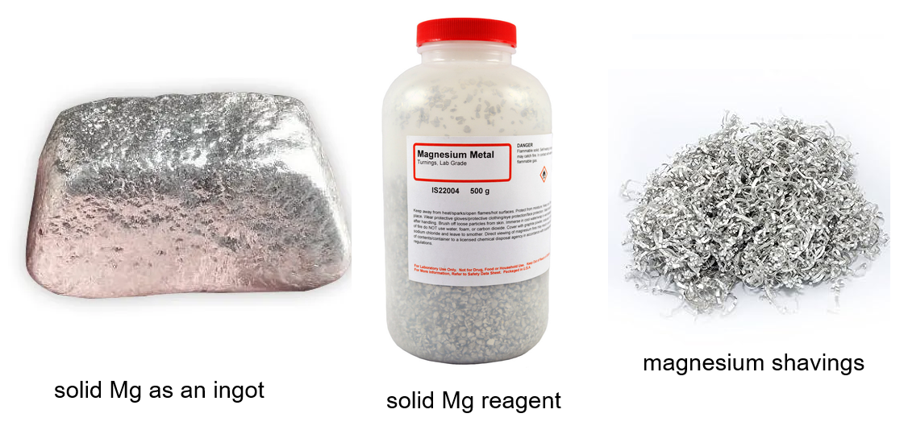
Introduction
Observe reaction of solid magnesium with atmospheric oxygen to produce magnesium oxide
Mg (s) + O₂ (g) → Mg_{x}O_{y} (s)
Note the chemical reaction (equation) is not balanced

Slide 3
Background
The atom is the physical form of the element. Atoms of one type/identity will exist in very specific ratios with atoms of other elements to form compounds.
Compounds are generally of two types: ionic or molecular
Ionic compounds in solid form are characterized by a crystal lattice of ions held by strong electrostatic forces, resulting in hardness, high melting points, and brittleness
Molecular compounds in solid form consist of discrete molecules held by weaker intermolecular forces, leading to softer structures, lower melting points, and diverse physical states

Slide 4
Background
Ionic compounds that are crystal solids consist of a large network of cations and anions in a formula unit, with the ratio of elements being an empirical formula
Molecular formula of a molecular compound will be a multiple of the empirical formula
For this experiment, the goal is to determine empirical formula of an oxide of magnesium (Mg_{x}O_{y})

Slide 5
Experimental Variation/Error
With every experiment before the data is collected and the reaction done, it is useful to anticipate what might influence your results different from the ideal. For this experiment:
Incomplete combustion: perhaps only magnesium on surface of metal solid reacts with oxygen
  Break up ash to expose unreacted metal, reheat to avoid this
The atmosphere is 78% N₂ and 21% O₂, and at very high temperatures (2000°C), some Mg can react with N_{2:} 3 Mg (s) + N₂ (g) → Mg₃N₂ (s)
  Adding water to magnesium nitride would produce ammonia gas, but it is probably not enough to detect its odor
  Mg₃N₂ (s) + 6 H₂O (l) → 3 Mg(OH)₂ (aq) + 2 NH₃ (g)

Slide 6
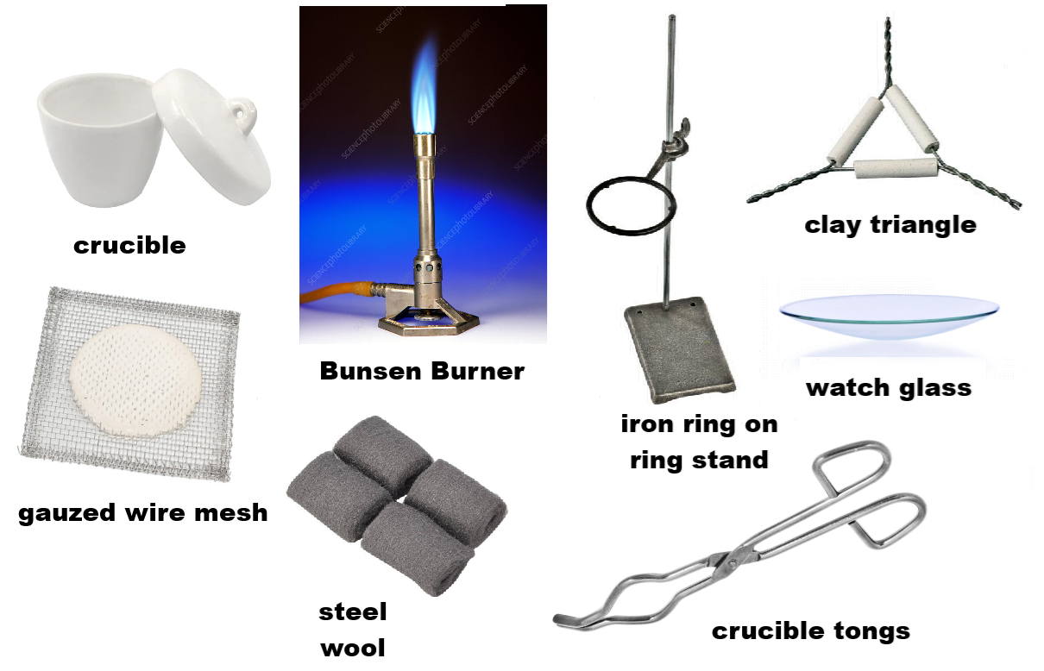
Equipment You Will Use

Slide 7
Lab Safety
Goggles
Correct Laboratory Coat
Gloves (nitrile of proper size)
Magnesium turnings/shavings can burn hot and can possibly burn through gloves, so you will keep your gloved hands a very respectable distance from crucible and use tongs to hold any crucible that has a burning reaction
Magnesium can burn BRIGHTLY so do not look directly at burning Mg for any long time

Slide 8
Procedure
Cleaning the Crucible (Yes, we’ve done this before)
NO WATER—crucible not to be cleaned with H₂O
If crucible dirty, use small steel wool piece to scrape out solids. Wipe with dry paper towel
Put crucible on stand and heat with blue-coned flame until slightly red hot
Use tongs to set crucible on wire mesh and let cool to room temperature (~5 minutes)
DO NOT SET ANY HOT CRUCIBLE ON COUNTERTOP OR ON PAPER OR THEY CAN BURN!

Slide 9
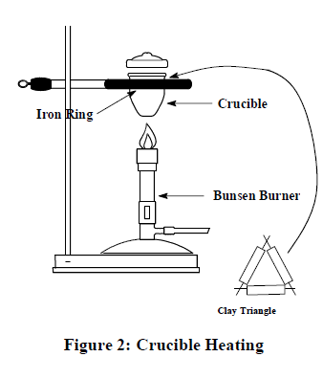
Procedure
Setup for crucible heating
Just as in a previous experiment

Slide 10
Procedure
Before Reaction
Determine mass of empty crucible AND NOT THE LID! → All digits of the balance
On glassine paper, use a scoopula to obtain
0.10 to 0.15 g Mg turnings and transfer to crucible
Record mass of Mg on tared balance (NO LID)
In the fume hood as for previous experiment, set up the stand with iron right, clay triangle, Bunsen burner with gas hose connected
Strike the gas to a flame & adjust the burner
Have the wire mesh ready to set the crucible on it for cooling

Slide 11
Procedure
Reaction
Place lid on crucible slightly ajar
Carefully hold or set the Bunsen burner to burn the magnesium. Do this for about 5 minutes
Take the lid off, which lets more air (oxygen) in
Continue to heat for another 15 min, but be prepared to put lid back on ajar temporarily if more “flaring” occurs
Let crucible cool on wire mesh about 5 minutes
MAKING SURE crucible has cooled, record mass of the reaction on balance (Post-reaction reading #1)
Reheat crucible (NO LID) for 10 min more and let cool. Record mass (Post-reaction reading #2)

Slide 12
Procedure
Post-Reaction
If the difference between Reading #1 and #2 are within ±0.001 g, proceed with the results. Use the GREATER value of the two mass readings
If the two readings have differences larger than 0.001 g, repeat the heating step to get the difference down. Magnesium oxide is a white powder, but could be light gray because of impurities

Slide 13
Clean Up
The magnesium oxide product goes in the Solid Waste container
WITHOUT AT ALL GETTING CRUCIBLE WET WITH ANY WATER, wipe crucible with dry paper towel or use steel wool to clean

Slide 14
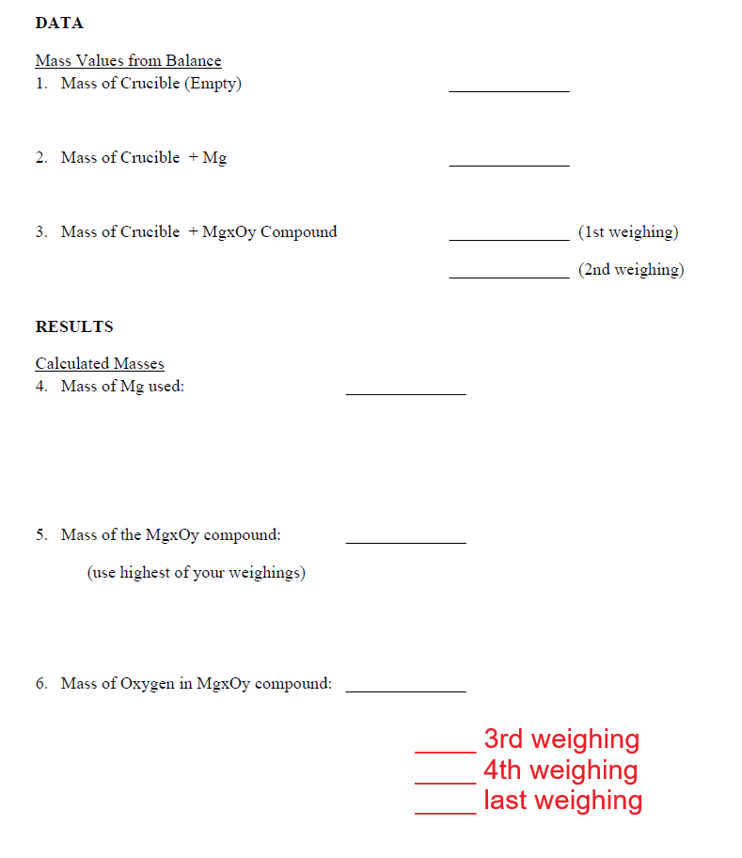
Data
All mass readings in Data should be ALL the digits of the balance. All quantities should be numbers with units (g)
If your “2nd weighing”
required reheating to get a
“3rd weighing” and even more
then you should have a
“first weighing” and
“last weighing”

Slide 15
My Open Math Form
The Canvas app contains an Assignment (check Modules too) for Experiment 5a
This contains a form you can use to assist
in your data analysis
  The form should not be connected to the Gradebook
The form will not be able to help you answer the thought questions (#5 and #6 on the online form, Post-Lab questions #2 and #3 in the printed Chem 3A Lab manual)
To answer those questions, consider what you have learned in lecture and reading the book

Slide 16
Results
All calculations should show number values with proper significant digits (for multiplication/division operations) and decimal places (for addition/subtraction operations)
Remember to use the GREATEST / HIGHEST value of any multiple mass readings you took in the post-reaction material

Slide 17
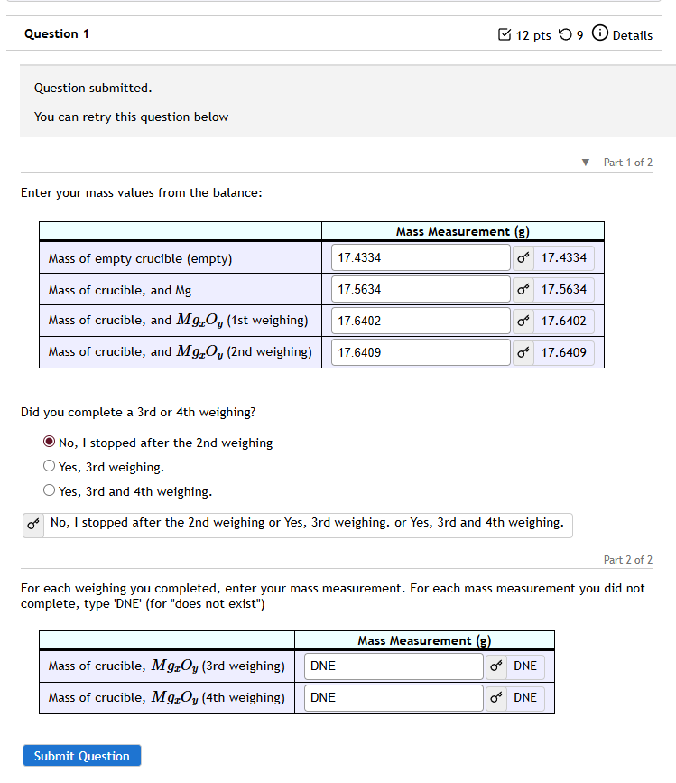

Slide 18
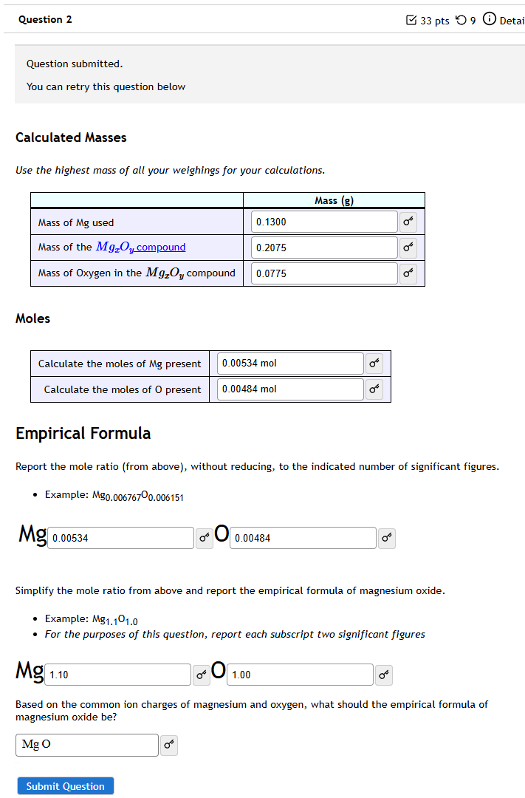

Slide 19
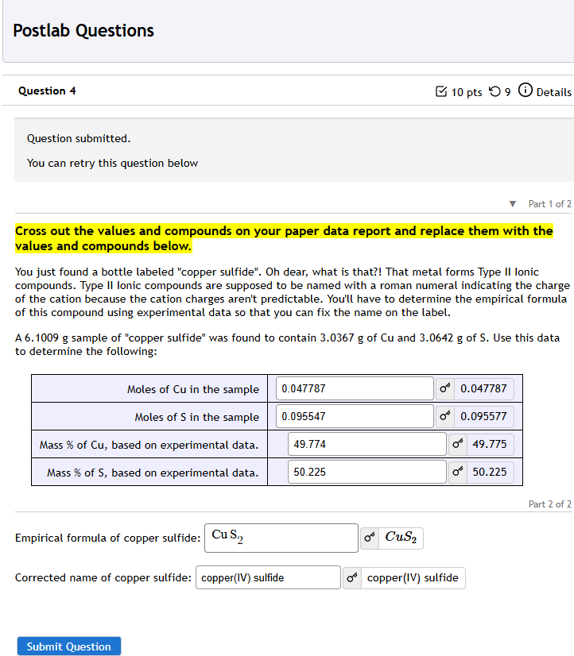
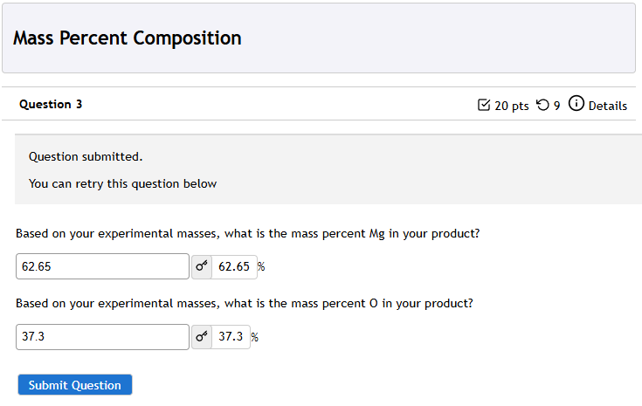

Slide 20
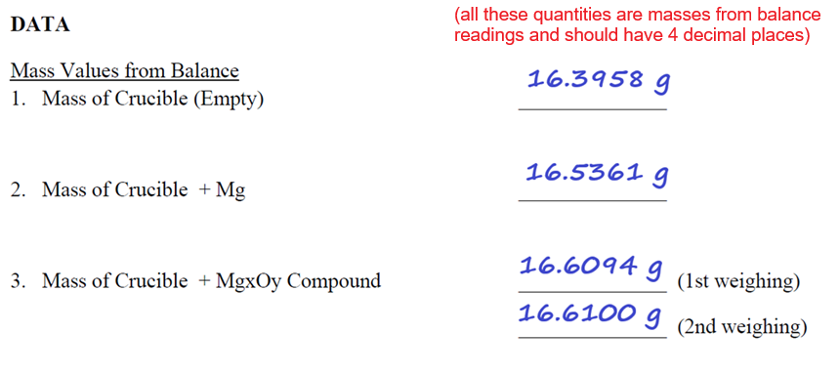
Example Data Analysis

Slide 21
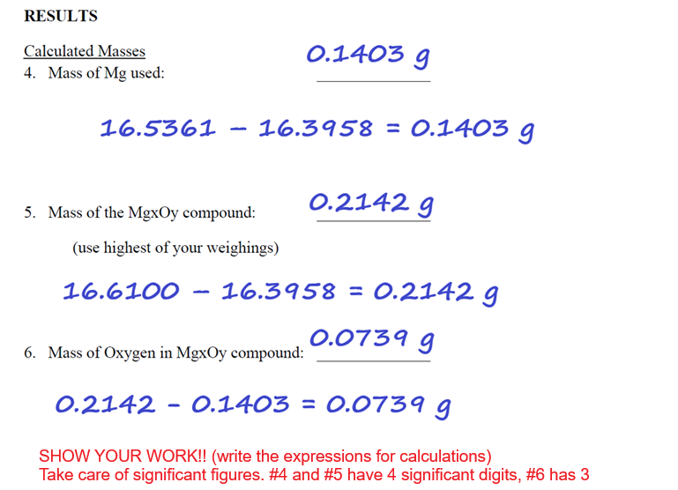
Example Data Analysis

Slide 22
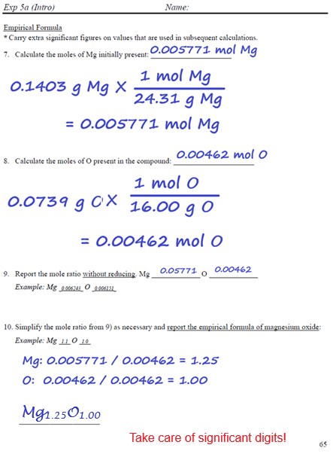
Example Data Analysis

Slide 23
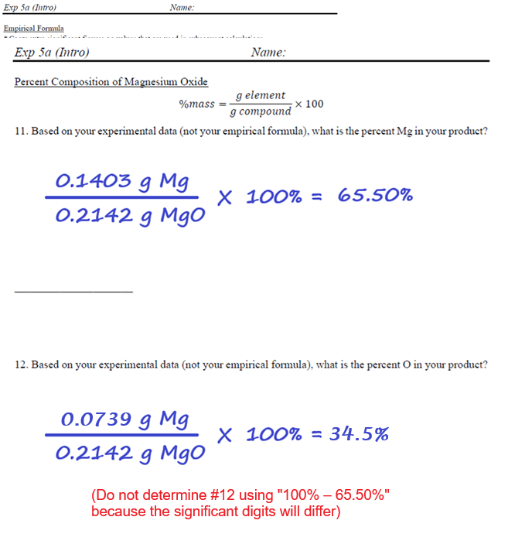
Example Data Analysis

Slide 24
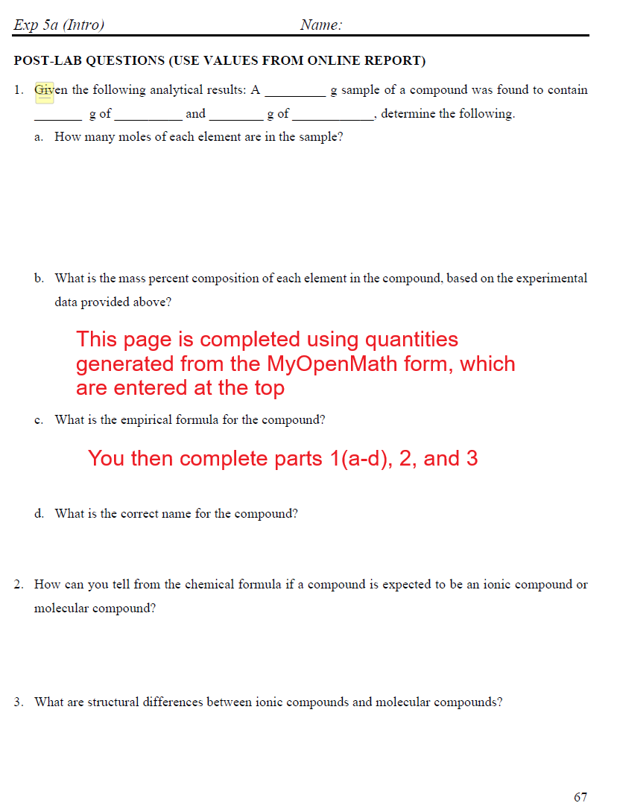
Example Data Analysis

